Slide 1
AGM Presentation

Slide 2
RQ + Assumptions
How does F1 Policy Affect Competiveness
Will it an agent based model of F1, produce dynamics
Assumptions
Driver Agents are initialized at age 18 ( therefore age will not be highly correlated in version 1)
Low Performing Driver agents added to driver pool( driver pool always increase in experience and other attributes)

Slide 3
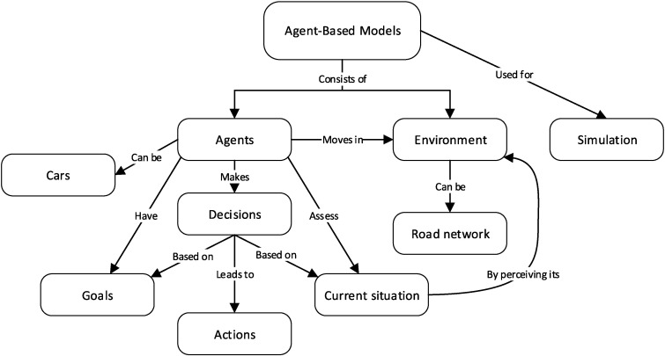
What IS AGM

Slide 4
Driver Agent
Best Driver -> Trajectory Planning -> Search Algorithim (Each drivers choose a trajectory on the track, out of millions path, that are on given track, the quickest (from point A to point B) over many sim runs is defining of a good driver agent
Driver Rating -> Linear relationship with performance
Experience -> intiliazed as a log relationship , capped at limit per track
Experience per track ( experience can accumulated by driving track more consistenly, but there is a limit on “unseen tracks” -> but general experience can be transferred to influence performance
Ability -> random distributed, but can maybe index from georegions, education leve
Racecraft -> Experience + ability -> directly influences performance on a said track
Marketability -> Linear relationship with Team’s budget
Morale -> wealky correlated relaitosnhip with Team

Slide 5
Global Factors
Track Age -> influences their driveability, trajectories are thrown -> direct influence in search algorithim -> could be gentic algorithim, and concied with results of search algorithim -> inverse exponential growth -> higher age , higher mutation

Slide 6
Team Agent
Budget -> randomly distributed
Development function
Morale -> function(team performance, upgrade rate)
Upgrade rate -> value between 0 and 1 per race ( initilzaed every season)
Desing Strategy -> Net Change of performance (history ) , prediction of car rating + log(driver rating) (low influence) + budget

Slide 7
Track Agent

Slide 8
Car Agent

Slide 9
Coefficents
Exponetial Regression and Linear Regression coeffiencts will be imported from real-world data
Then applied to create functional relationships at initial stages
When enough data has been created, where a normal distribution of samples collected has confirmed , models will be built with simulation data and then applied thereafter

Slide 10
Authority Agent
Aggressive
Balanced
Leninet

Slide 11
Version 2
Driver Ratings -> will introduce weigthings on how good a given team is compared to another time , better indicating of performance
Driver ratings -> will be modelled as a difference equation ( and any fixed points will be penalized)
Trajectory Planning -> Slight variations in a race to a trajectory
Ability -> random distributed, but can maybe index from georegions, education level
Can even label ability ranges in different bins ( “average”,”generational talent” etc
Upgrade rate adjusted every season or can be constant to a team
Introduce Regime Shifts
Mechanics of Track Replacement
Mechancis for new Track Generation
DES Model for simulation of lap times
Authority
Track of trajectories ,teams and driver performance
Generate new policies based on data accumulate
Version 3
Hierarchal models (Level Space ?)
Models will be built individually for each agent class( track, environment, race-car)

Slide 12
Visuals
Bifurcation Diagram
Sankey Diagrams

